Slide 1


Prediction of the suspended particle Matter in the Wadden Sea Using ML
Carmen Martinez-Barbosa, Fine Wilms, Bob Smiths, Peter Herman, Willem Stolte, Julia Vroom

Slide 2
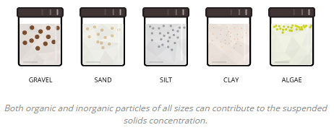
SPM affects: sediment transport; resuspension; dredging.
SPM dynamics at intermediate/long time scales is very unclear.
Big uncertainty in numerical models on the interplay between SPM and physical, chemical and biological processes.
Case study: Dutch Wadden Sea
Phase I
Creation of a data-driven model of SPM for the Wadden Sea.
To have a quantitative understanding of the change of the spm content in terms of some of its key drivers.
Phase II
Extend model to be applicable to the whole region
Credit: www.fondriest.com

Slide 3
data

Slide 4
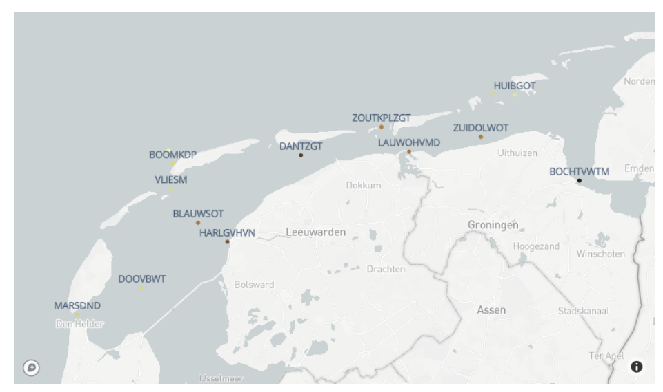
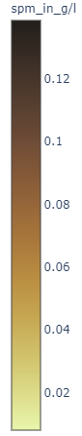
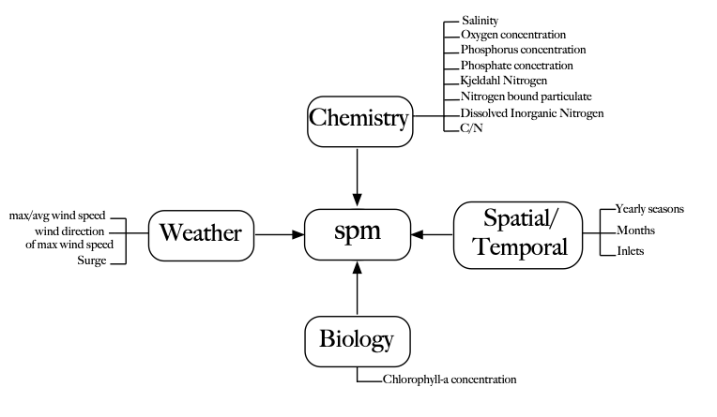
the Dutch archive of monitoring water data
KNMI
1990- 2018
Water level from the Dutch archive of monitoring water data. Matlab script to get the surge.
the Dutch archive of monitoring water data

Slide 5
Machine learning Modelling

Slide 6

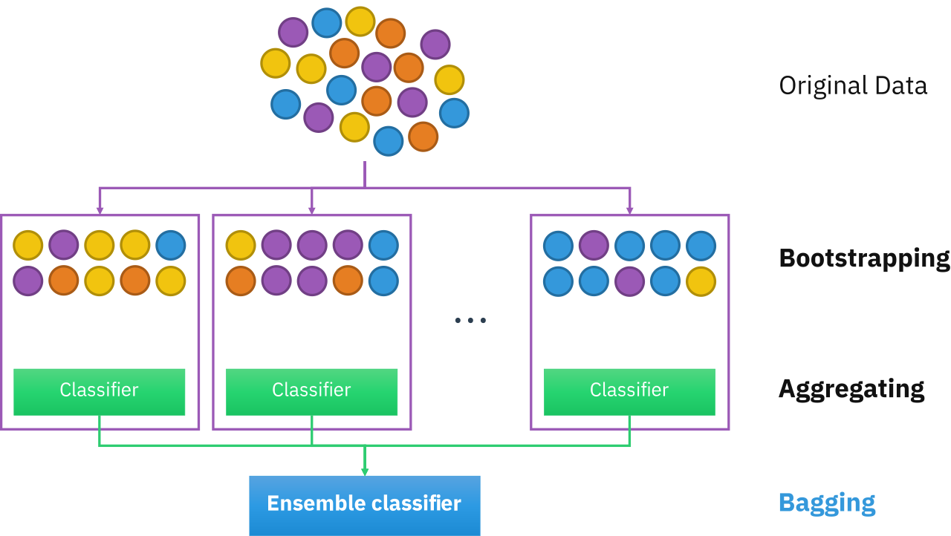
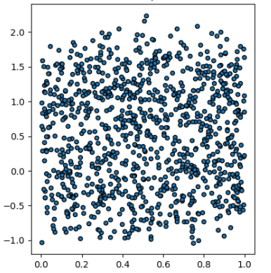
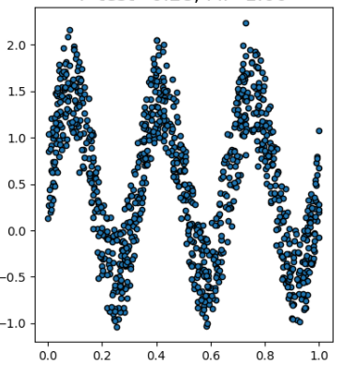
Ensemble of Trees Methods
High variance
low variance
Credit: Wikipedia
y
y
X1
X2

Slide 7
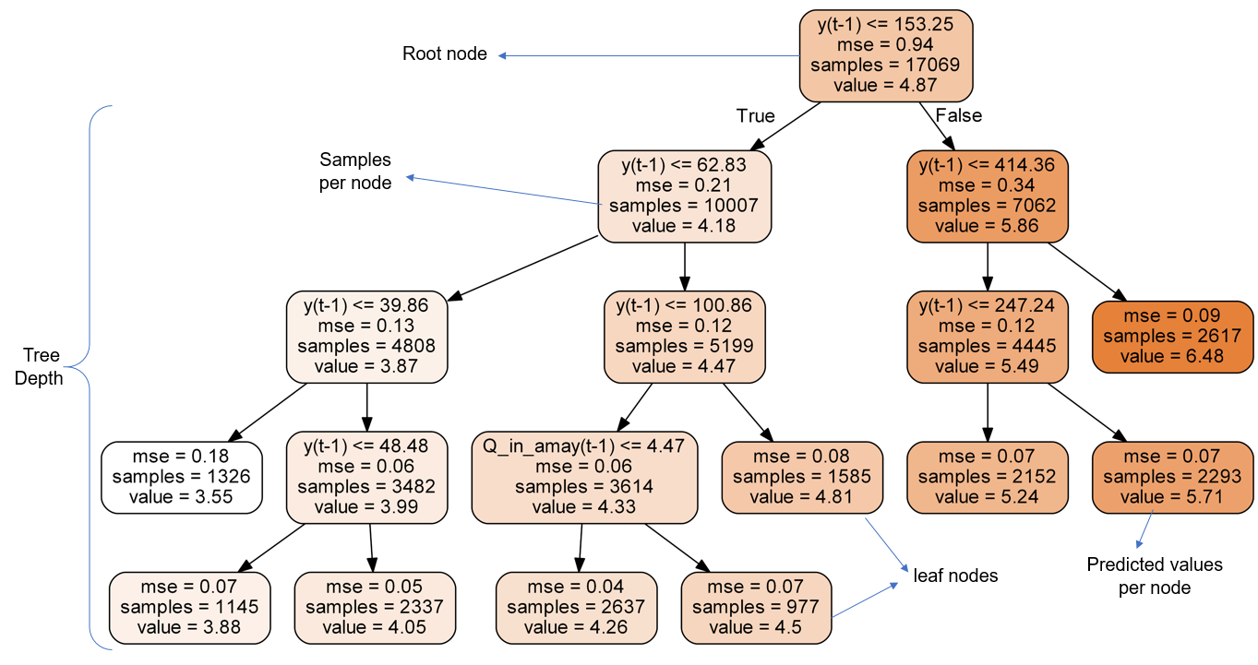
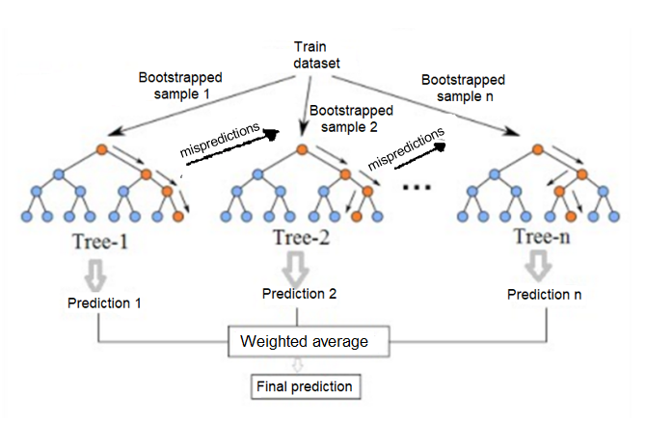
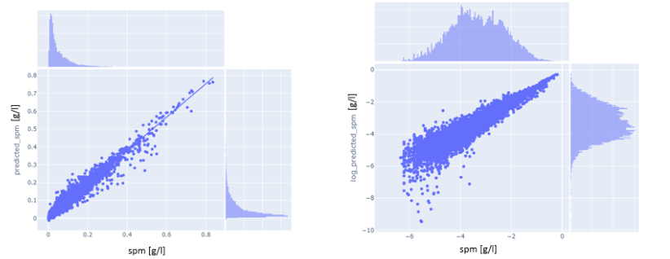
Train/test = 80%/ 20%; (20% of train for validation)
XGBoost
Error metrics:
RMSE: 0.015 +/- 0.001 g/l (baseline: 0.07 g/l)
R²: 0.95 +/- 0.005 (baseline: 0.1)
Removing chemical components:
RMSE: 0.04 +/- 0.001 g/l
R²: 0.78 +/- 0.005

Slide 8
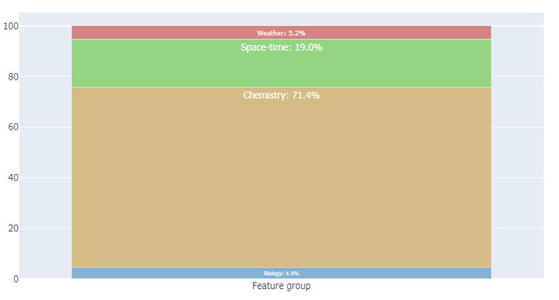

Slide 9
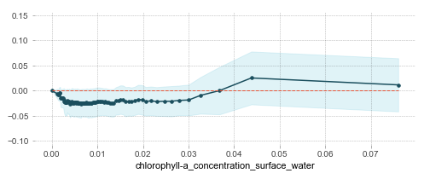
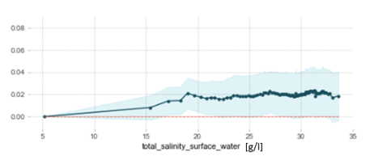
Δspm [g/l]
[mg/l]
In fresh water, the spm content is highly variable while in salty water, the spm remains constant. This was also found by Middelburg & Hermann (2007).
Disadvantages of this approach:
It can be used only in the locations where the model was trained.
As consequence the model is hard to compare with numerical simulations.
Δspm [g/l]

Slide 10
Phase II
Full spatial coverage of spm using remote sensing

Slide 11

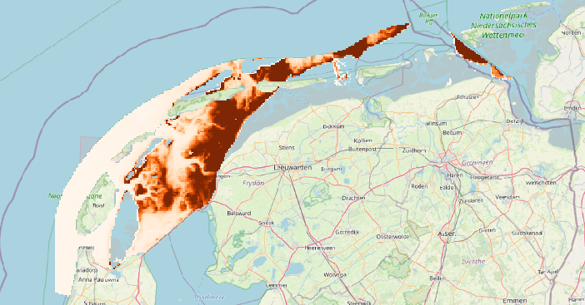
2016
Suspended matter
2018

Slide 12
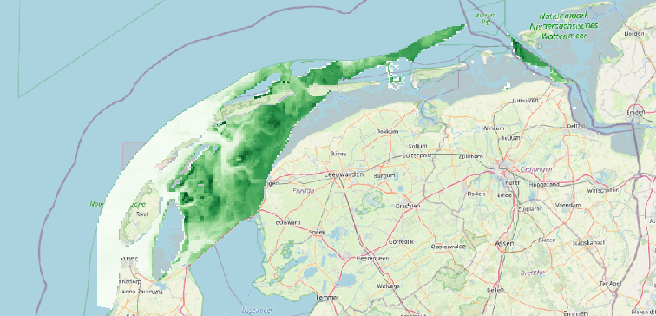
2016
Chlorophyll-a
2018

Slide 13
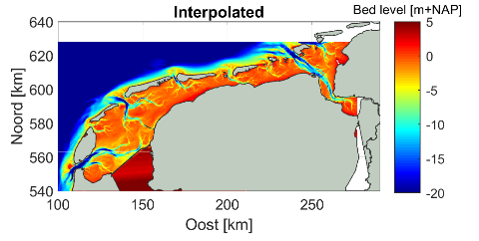
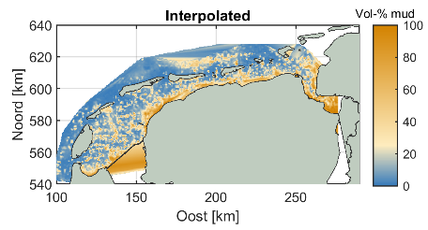
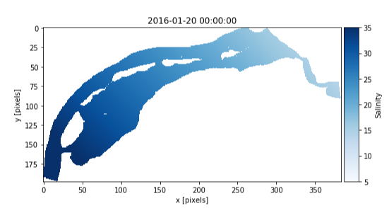
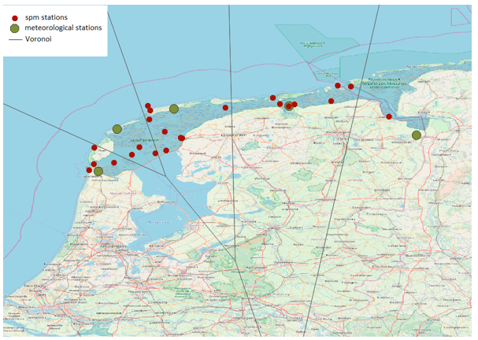
Suspended matter
wind
Grid resolution:
400 m x 400m
+ interpolated surge

Slide 14
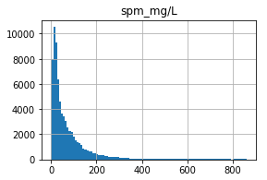
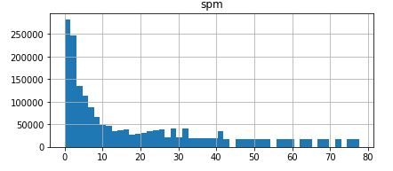
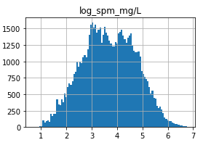
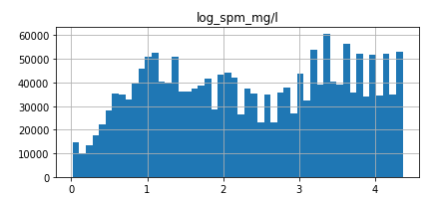
In-situ observations
Remote sensing data
No data available for spm > 100 mg/L.
Atmospheric correction algorithm takes these pixels
As clouds.
% observations with spm>100 mg/L
spm [mg/L]
In-situ | Remote sensing
20 % | 10%
spm [mg/L]
Log spm [mg/L]
Log spm [mg/L]

Slide 15
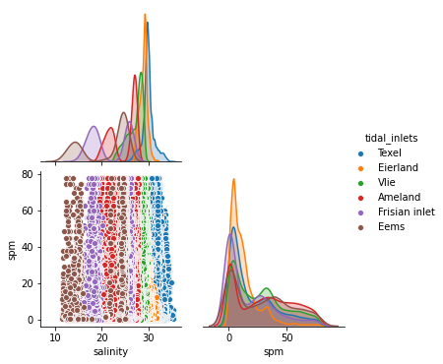
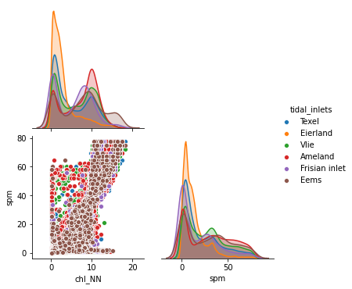
High variance in data when taking into account all inlets and all months.
We build models for each month.

Slide 16
Machine learning Modelling

Slide 17




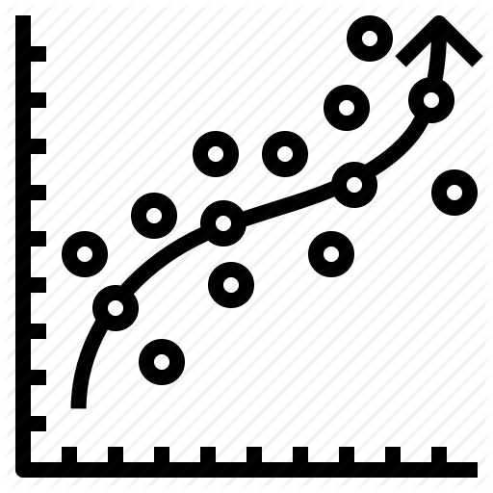
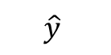
$$\hat{y}$$
Ensembles
of trees
Neural
networks
Generalized
linear models
Ensemble of models
(all or by family)
Random
Forest
Extreme
Random
Forest
Boosting
methods
http://docs.h2o.ai/h2o/latest-stable/h2o-docs/automl.html?highlight=automl

Slide 18
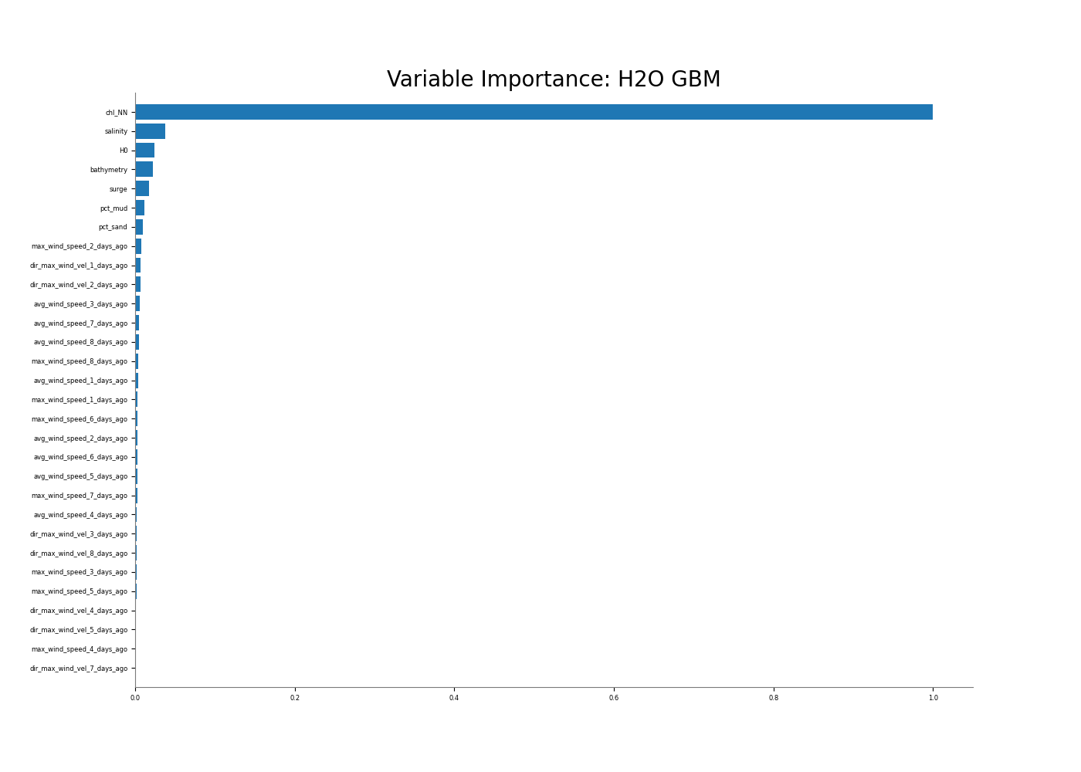
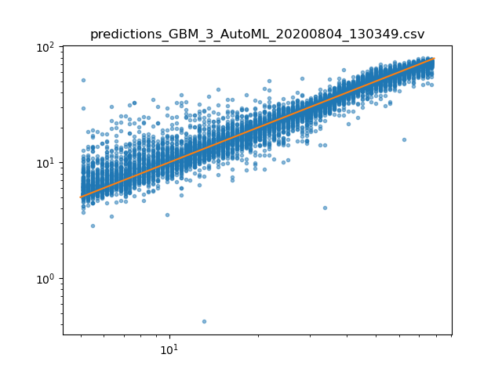
Model 1: with simulated waves from dFlowFM
Data for 2017
First training on January to obtain
important features.
Trained a model on every month
with important features.
Test on hold-out dataset. (80%/20%)
Top 5 features:
Chlorophyll-a
Salinity
H0
Bathymetry
Surge
Model | RMSE | MAE
Ensemble all models | 5.08 mg/L | 3.15 mg/L
GBM | 5.22 mg/L | 3.29 mg/L
Model 2:
Model with no waves, same year period shows similar results.
Residuals January

Slide 19
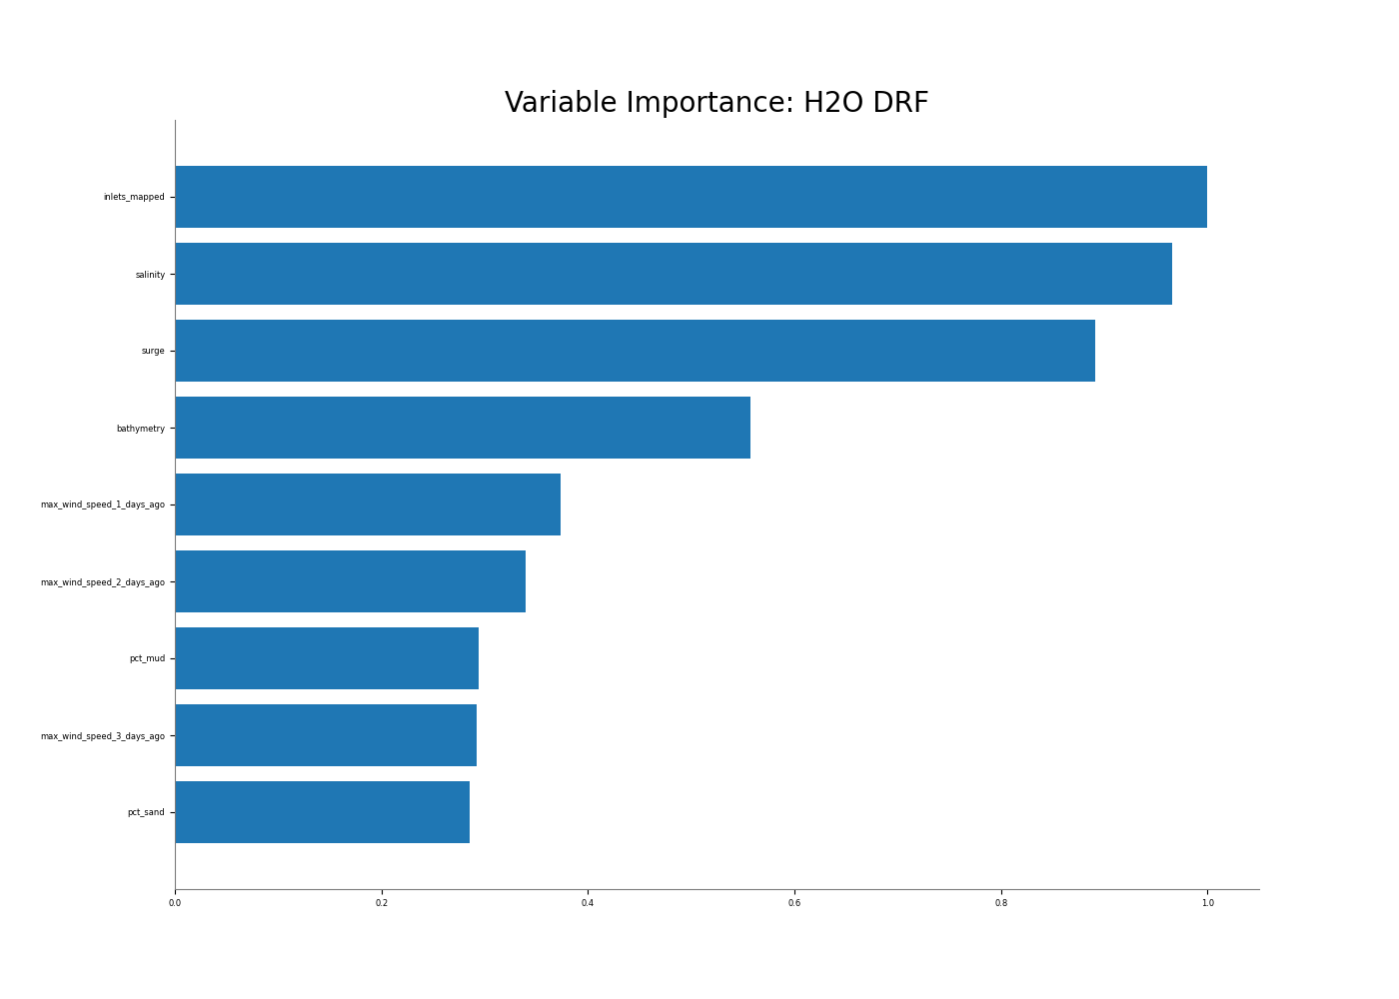
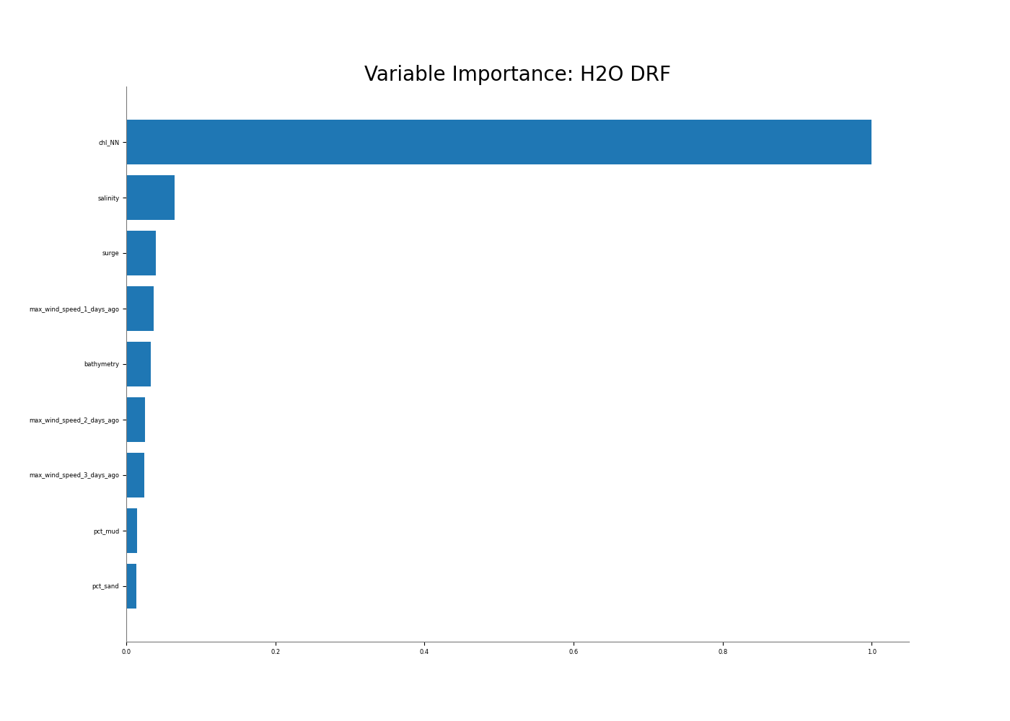
Model 3: All variables
Data for 2016-2018
First training on January to obtain
important features.
Trained on 12 month with important features.
Test on hold-out dataset.
Top 3 features model with no Chlorophyll-a:
inlets
salinity
surge
 | Model | RMSE (mg/L) | MAE (mg/L)
No Chrolophyll | Ensemble all models | 10.21 | 6.93
 | DRF | 10.30 | 7.02
Chrolophyll | Ensemble all models | 4.45 | 2.76
 | DRF | 4.57 | 2.83
Top 3 features model with Chlorophyll-a:
Chlorophyll-a
salinity
surge

Slide 20
Take home messages

Slide 21
We have developed a data-driven model for the Wadden Sea using a combination of in-situ measurements and remote sensing.
The model can be used to obtain the spm content in any region of the Wadden Sea, however:
- It is not suitable for muddy areas (spm > 100 mg/L)
- spm variations at long term can be studied (training on 2 years of data), but PROCESSES AT SMALL SPATIAL SCALES ARE NOT COVERED BY THE ML MODEL.
Chlorophyll is the most important feature in the ML model.
Other important features in the ML model are: salinity, inlets and surge
Next Steps:
Compare the results from the numerical model with those obtained in this study.
See whether it is possible to use this ML model in studies carried out in the region.
Write a scientific paper.

Slide 22

Thank you

